Slide 1
Practical investigation of Rayleigh fading model in URC conditions
Andreas Vembe Jäger Mads Røgeskov Gotthardsen Markos Vourvachis Thomas Kær Juel Jørgensen

Slide 2
Agenda
Notes:
Add picture for 5G

Slide 3
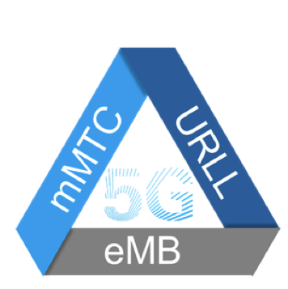
Introduction
Notes:
Fading and multipath outages
Ultra Reliable Low Latency Communication(URLLC) 5G
Cable replacement
Low latency means low error correction coding
Future applications

Slide 4
Introduction
Notes:
Rayleigh fading channels
“Log-Log linear”
Fading gain of 10e-5 / -50dB
Extrapolated models

Slide 5
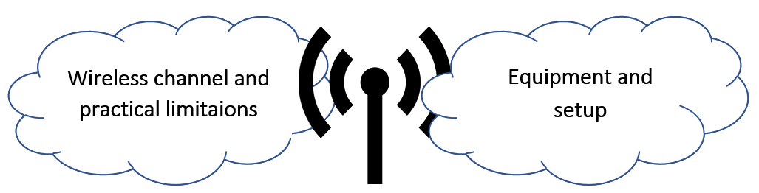
Problem statement
Design a measurement system that can handle very deep fades and a statistical method to process the data and compare to existing Rayleigh model used in URLLC channels.

Slide 6
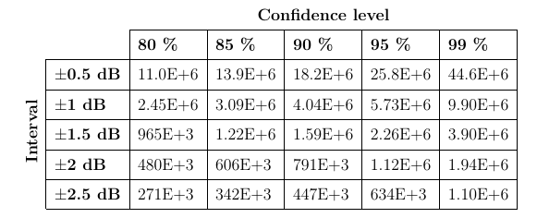
Statistical Aspect
Notes:
Estimation of sample pool.
Normal approximation of the Binomial proportion.
Confidence level and interval
The goal was 90% and ±1dB respectivly
Important sampling
Bootstrap method
Simulation of bootstrap method

Slide 7
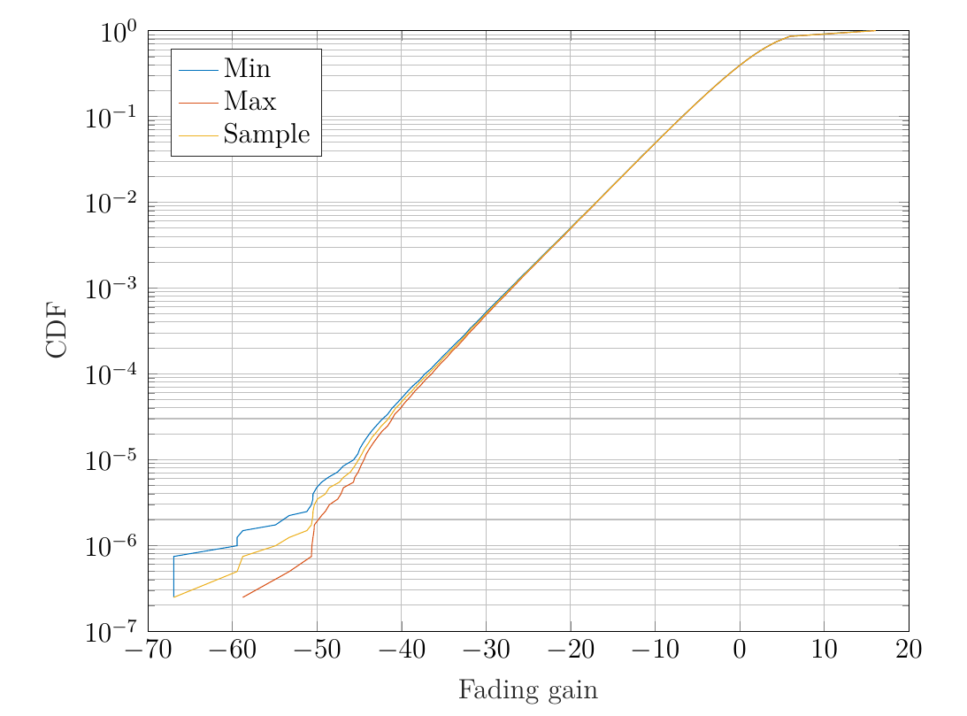
Statistical Aspect
Notes:
Estimation of sample pool.
Normal approximation of the Binomial proportion.
Confidence level and interval
The goal was 90% and ±1dB respectivly
Important sampling
Bootstrap method
Simulation of bootstrap method

Slide 8
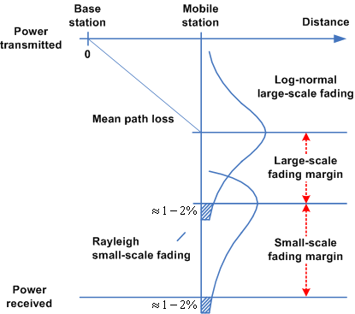
Wireless Channel
Notes:
Multipath fading
Large scale
Small scale
Flat Fading
Selective Fading

Slide 9
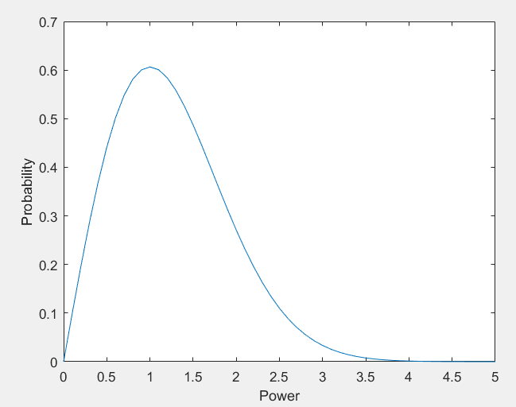
Wireless Channel
Notes:
Rayleigh Fading(Non-Line Of Sight , Urban fading model)

Slide 10
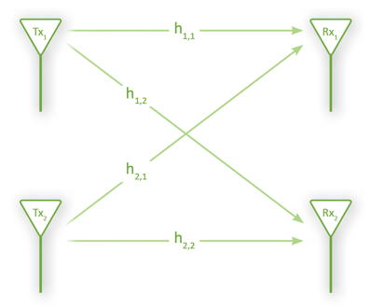

Wireless Channel
Temporal diversity
Spatial diversity

Slide 11
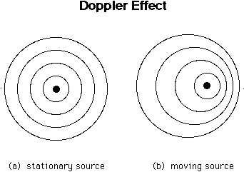
Doppler Bandwidth

Slide 12
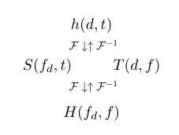
Wireless Channel Characteristics
Notes:
Multipath fading channels are described by 2 domains(Temporal-Spatial).
Utilization of both domains for a large sample pool.
Domain Transformation with FFT.
4 representations(insert picture here)

